Slide 1
Gender (in)equality and climate justice
Topic policy environment overview
By Annie Bennett

Slide 2
Overview!
Cultural norms as well as policies impact gender equality
Increasing gender equality is crucial to improving climate change and promoting progressive goals for the environment.
This is really important!!
”No country (or planet) can truly flourish if it stifles the potential of its women and deprives itself of the contributions of (roughly) half of its citizens.” –Michelle Obama

Slide 3
Why I care
Teach gender equality workshops in Malawi every other summer
Blogs:
https://borgenproject.org/gender-inequality-in-malawi/
https://borgenproject.org/girls-education-in-malawi-an-overlooked-solution-to-poverty/
Really passionate about feminism and the environment and I like seeing how they overlap
Two birds, one stone.

Slide 4
Formal Policies/ Organizational Changes
Specific lass/mandates

Slide 5
Heinrich Böll Stiftung
“The Heinrich Böll Foundation stands for green ideas and projects, is a reform policy workshop for the future and an international network. … Heinrich Böll's encouragement of civil society interference in politics is a model for the work of the foundation. Its primary task is political education in Germany and abroad to promote the democratic will, the socio-political commitment and international understanding. It is guided by the basic political values of ecology, democracy, solidarity, and nonviolence. She is particularly interested in the realization of a democratic immigration society as well as gender democracy as a relationship of the sexes that is free of dependence and domination.”

Slide 6
Green Climate Fund
Founded with a gender equality mandate
“The impacts of climate change affect women and men differently.”
Women have higher mortality rates from climate disasters
Domestic work becomes much more involved with the challenges/obstacles that climate change creates
Women rely on natural resources more
Idk why though
Land/biomass production is more necessary for women than men
Men tend to have more resources to recover from climate disasters

Slide 7
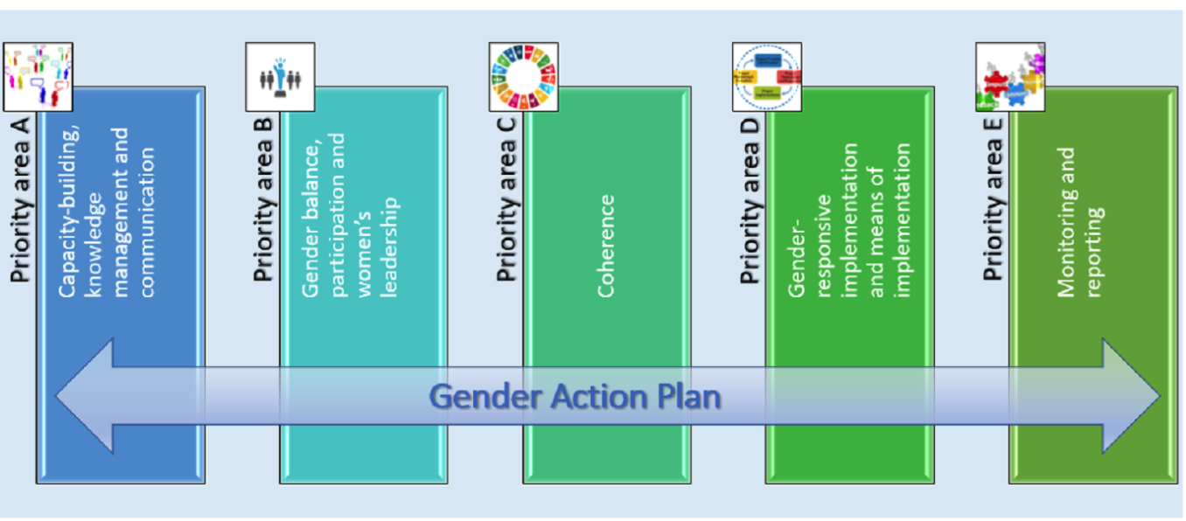
United Nations Gender Action Plan
Lima Work Programme
“Acknowledging the progress made in advancing gender balance and gender equality within the context of climate change policies and in line with the individual country circumstances and gender-responsive climate policy”

Slide 8
UN GAP (cont.)
“Recognizing with concern that climate change impacts on women and men can often differ owing to historical and current gender inequalities and multidimensional factors and can be more pronounced in developing countries and for local communities and indigenous peoples, Acknowledging that climate change is a common concern of humankind, Parties should, when taking action to address climate change, respect, promote and consider their respective obligations on human rights, the right to health, the rights of indigenous peoples, local communities, migrants, children, persons with disabilities and people in vulnerable situations and the right to development, as well as gender equality, empowerment of women and intergenerational equity”
Gender equality is one of the SDG

Slide 9
Informal policies
Education, fertility, career, and more

Slide 10
Introduction
Women face barriers getting educated, which results in a lack of ability to own property
Can’t voice needs/ideas in regard to global warming
“Climate action that disregards half the population cannot be efficient or effective.” – United Nations
Increasing girls’ education and contraception/abortion access lowers the number of kids being born, which helps the environment and women
In the Global South, women are in charge of growing food
Climate change directly impacts their livelihoods by drying up land and limiting irrigation

Slide 11
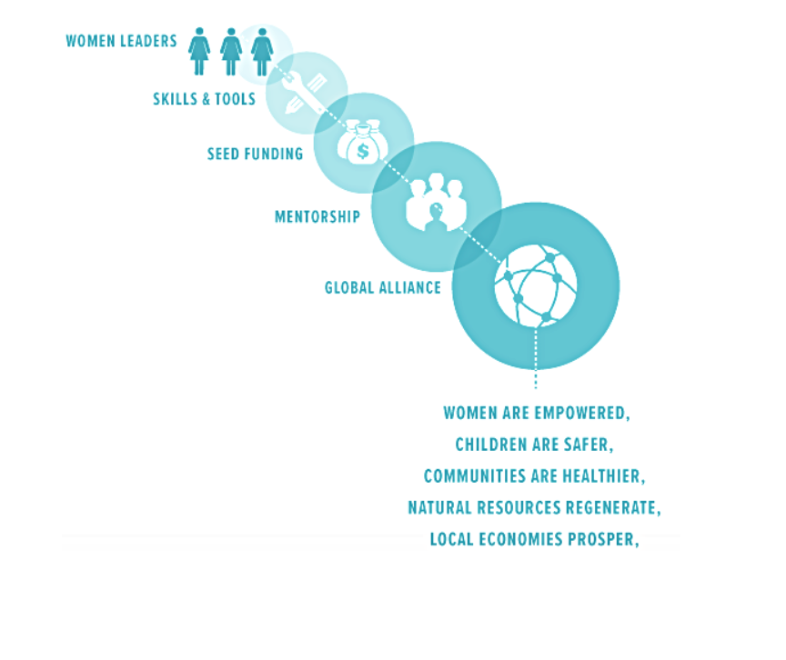
Education and Fertility
Project Drawdown
“Some initiatives, designed primarily to ensure rights and foster equality, also have cascading benefits to climate change. They include access to high-quality, voluntary reproductive healthcare and to high-quality, inclusive education, which are fundamental human rights and cornerstones of gender equality.”
Women’s Earth Alliance
Women produce more food but own less land. They spend 200 million hours per day collecting water, losing access to education and enduring violence. Women carry more of the pesticides and pass them on to fetuses. Areas with more environmental destruction also have higher circumstances of violence against women.
“When Women Thrive, The Earth Thrives.”

Slide 12
“Women and girls make up more than half the world’s population — and they are on the frontlines — often more deeply impacted than men and boys by poverty, climate change, food insecurity, lack of healthcare, and global economic crises. Their contributions and leadership are central to finding a solution.” — UN Women
From the WEA website

Slide 13
Solutions
Equitable and gender responsive climate finance solutions
Provide social/gender experts in plans, not just technical experts
Allow more women in climate funds, government, and other legislative bodies
Make funds directly available to women and women’s advocacy groups
Include women on the ground in climate projects
Consultation & implementation

Slide 14
Sources
https://womensearthalliance.org/
https://www.drawdown.org/sectors/health-and-education
https://unfccc.int/files/meetings/lima_dec_2014/decisions/application/pdf/auv_cop20_gender.pdf
https://www.boell.de/en/2019/06/05/who-we-are-and-what-we-want?dimension1=startseite
https://unfccc.int/sites/default/files/resource/cp2019_L03E.pdf
https://unfccc.int/topics/gender/the-big-picture/introduction-to-gender-and-climate-change/the-gender-action-plan-1
https://unfccc.int/gender

